Slide 1
Revision
Text books – school
Revision Packs
Past Papers
Revision Books
Revision websites
100% Book
How to Revise
Study Skills Week
Nudges
Revision schedules

Slide 2
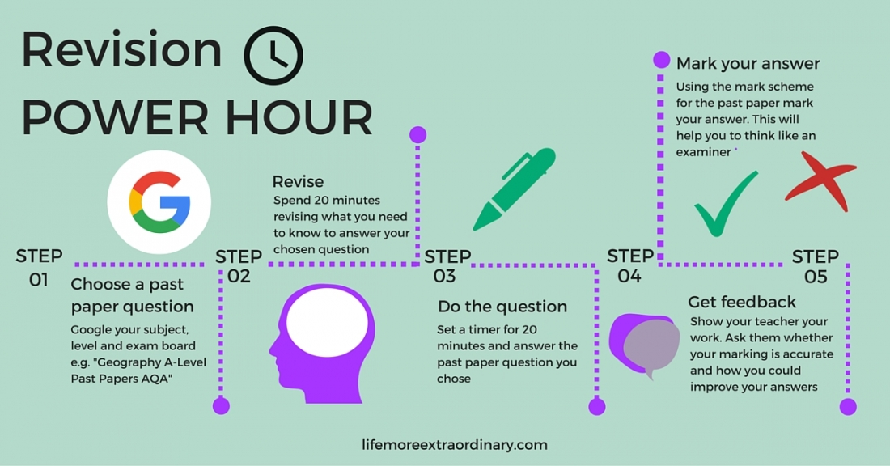
In a revision power hour, set yourself clear smart targets to complete. Don’t just set yourself a target to revise for one hour. Set yourself three specific achievable tasks to complete within the hour. One of these tasks must be writing an exam answer in timed conditions. This is effective revision.

Slide 3
A tracking sheet used in previous years
8
9
9
RS
I
RS
18
English
II
I
PE
I
Maths
II
Geog
Maths
III
French
Physics
Biol
II

Slide 4
4 corners for effective revision

Slide 5
Research by Bjork, Dunlosky and Kornell (2012) has demonstrated that students don't like to use the most effective revision techniques like self-testing (they don't think it aids their learning), or using flashcards and quizzing.
Not only that, students also routinely use less effective revision techniques, like rereading their class books and highlighting their notes.
So year 11 ... going forward....
'answer questions' when you are revising ...this will make
the greatest impact for you..
Mr Bowman

Slide 7
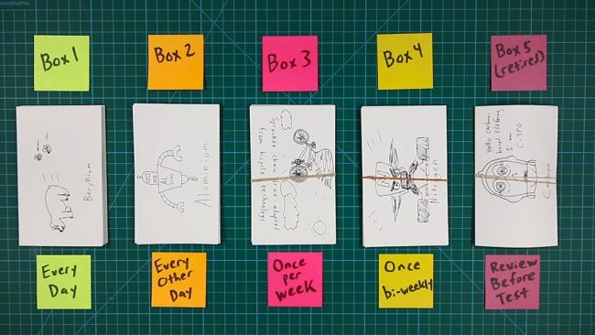
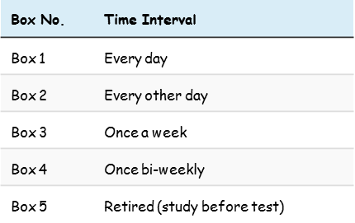
Revision Technique - Flashcards
A spaced repetition system for flashcards
Every card starts out in Box 1. When you get a card right, it graduates to the next box. If you get a card wrong, it goes all the way back to Box 1 – no matter where it was. In this way, you ensure that you’re studying the material that really challenges you.

Slide 8
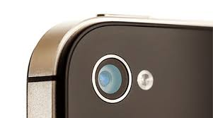
Try the Cornell strategy in your 100% book. Divide up a page in your 100% book into three sections as shown below. In area 1, write down everything you know about a certain topic. Two days later re-read area 1 and then add questions, or main theme ideas to area 2. A week later, revisit this page and re-read areas 1 and 2. Then write a concise summary in area 3. You have now transformed potential learning 3 times and hopefully it will now be embedded. Mr Harris
The theme of revenge in the Merchant of Venice
Shylock’s grudge against Antonio ‘ you call me a misbeliever, cut throat dog, and spit upon my Jewish gaberdine.. And foot me as you spurn a stranger cur’ ……
The bond –act of vengeance or light hearted joke ? ‘ a merry sport’….. Shylock wishes violent retribution on Jessica ‘I would my daughter were dead at my foot, and the jewels in her ear’….
Jessica’s betrayal seems to intensify Shylock’s hatred of Antonio I’ll plague him: ‘I’ll torture him’ ….
Shylock repeatedly refuses to show mercy during the trial ‘ The pound of flesh , which I demand of him, Is dearly bought: tis mine and I will have it’…
1
Shylock’s refusal to show mercy, while understandable, leads to his down fall. Shakespeare is showing the audience the consequence of vengeance
3
Take a picture of this slide and act upon it
2
The theme of revenge in the Merchant of Venice………

Slide 9
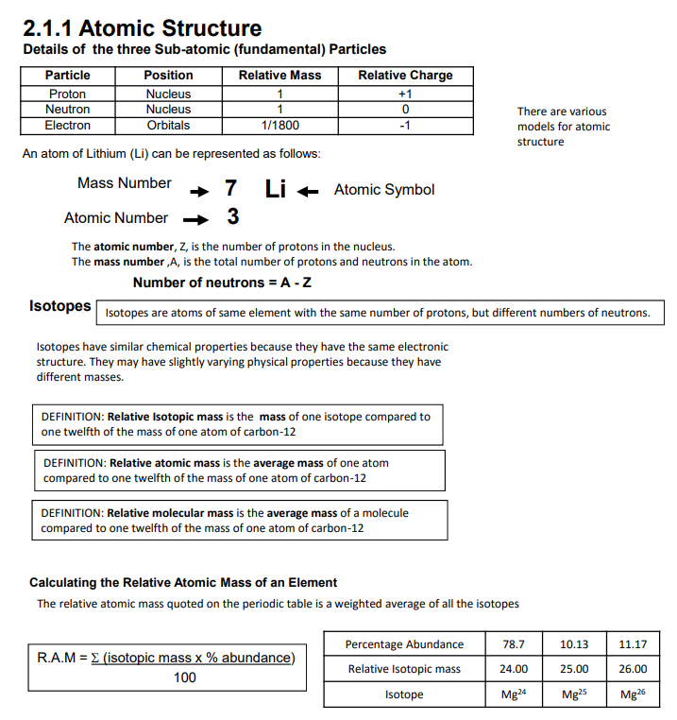
Revision Technique – Question & Answer strips
Ans
Ans
Ans
Ans
Half your page and crease it ….
So that you can reveal your answers.
Ans
Ans
Ans
Ans
Ans
Ans
Go to the GCSE Chemistry VLE. Make 20 questions and answers for this chemistry topic. At least 4 of your questions, must start with the question stem ‘describe’ and 4 must start with the stem ‘explain’. Present your questions and answers in two different colours. Read all six pages on this topic.

Slide 10
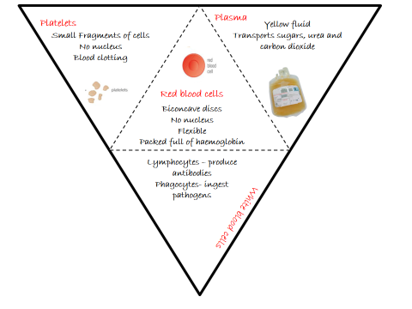
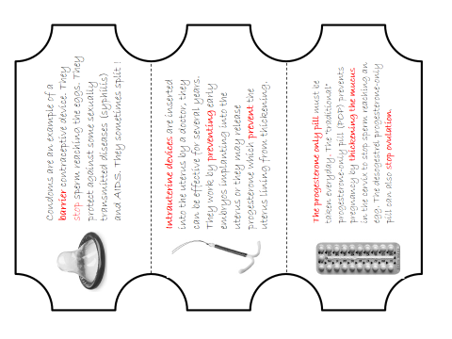
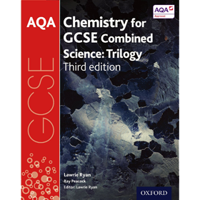
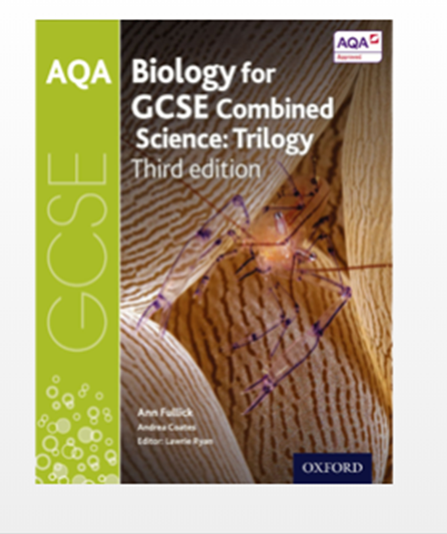
100% foldable tasks
100 % Book
Biology /Chemistry
Foldable Revision Aids
Take charge of your learning
VLE : Combined Science Chemistry (Trilogy) - from 2016
VLE: Combined Science BIology (Trilogy) - from 2016

Slide 11
Blood 100% foldable task
p.52-53
p.52-53
Sometimes, you need to mix up the way you make your revision notes……. to improve your motivation…… Try this method
Mr Bowman
Cut out the template along the bold lines and crease along the dotted lines. You have then made a foldable, which you could stick (the middle panel) into your 100 % book.
Look at the syllabus statements, could you summarise your knowledge of Plasma, Platelets, Red Blood cells and White blood cells ?

Slide 12
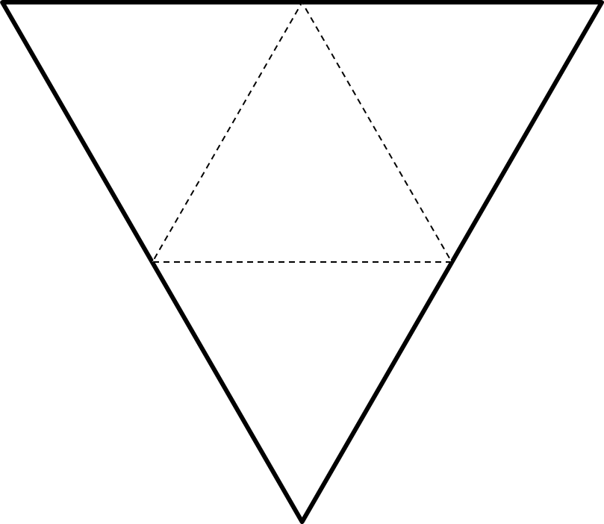
Platelets
Plasma
Yellow fluid
Transports sugars, urea and carbon dioxide
Small Fragments of cells
No nucleus
Blood clotting
Red blood cells
Biconcave discs
No nucleus
Flexible
Packed full of haemoglobin
Lymphocytes – produce antibodies
Phagocytes- ingest
pathogens
White blood cells

